Slide 1






Department of Computer and Informatics Engineering
IMPLEMENTATION OF MOBILE-BASED EXPERT SYSTEM FOR EARLY DETECTION OF DEPRESSION
ARE YOU OKAY?
Created by:
Nurul Amala Azza & Ufairoh Nabihah

Slide 2



What is depression?
Mental Disorder
THAT HAVE VARIOUS SYMPTOMS:
Physic
Psychology
Social Behaviour

Slide 3
91%
Indonesians who has mental disorder didn't get a proper treatment in 2018
Source: Fundamental Health Research

Slide 4


Indication
Lack of mental health facilities
Lack of understanding mental health

Slide 5


Solution
Detect Depression
use
mobile-based
expert system

Slide 6


Expert System
Artificial Intelligence system that can adopt expert’s knowledge so computer can solve problems like an expert

Slide 7
ARE YOU OKAY?
Application that can detect depression using certainty factor expert system.

Slide 8
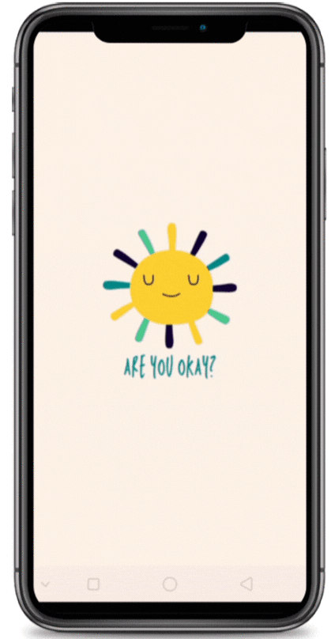
ARE YOU OKAY?
detect depression using certainty factor expert system

Slide 9
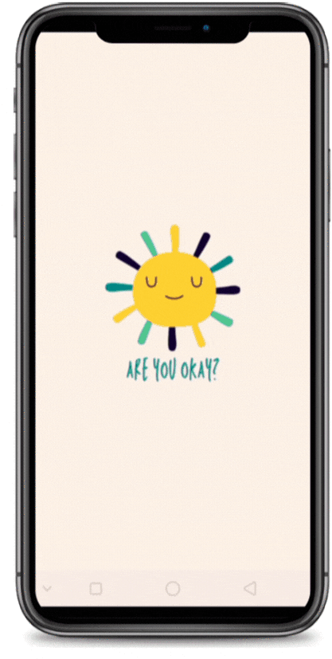
ARE YOU OKAY?
Read an article about
mental health

Slide 10

THANK YOU
ARE YOU OKAY?

